Slide 1

Course Code: MATH 211
Course Title: MATH III
Lecture 9 (Cauchy’s Integral Formula )
Tazin Tamanna
Lecturer in Mathematics
Department of Science and Humanities
M.Sc. in Applied Mathematics (KU)
B.Sc. in Mathematics (KU)

Slide 2
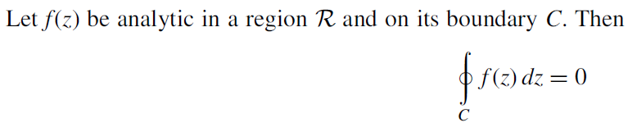
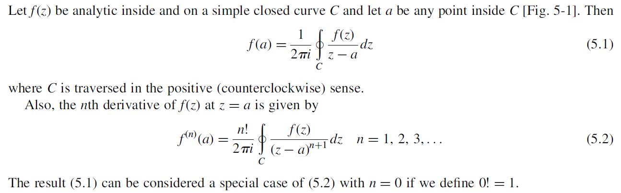
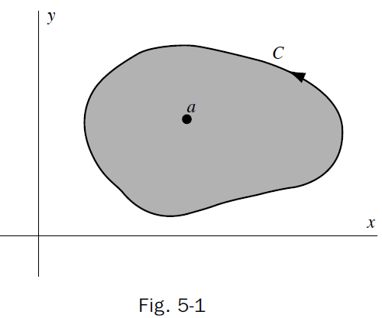
Cauchy’s Theorem
Cauchy’s Integral Formula

Slide 3
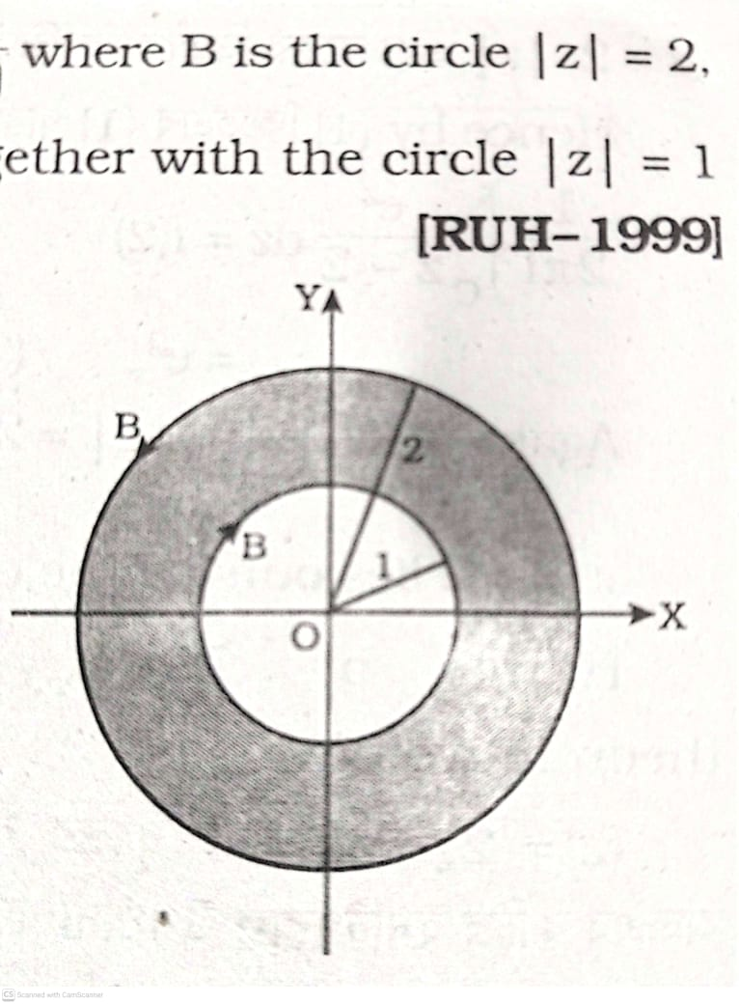

Slide 4
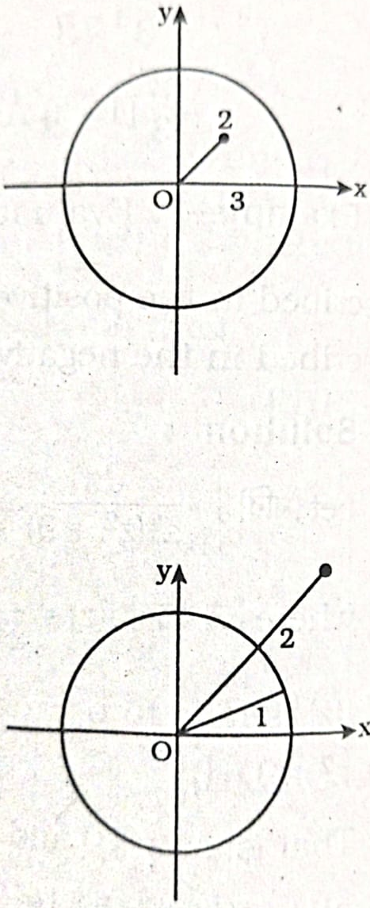

Slide 6
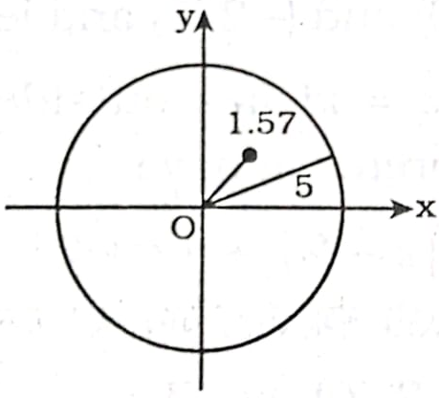

Slide 8
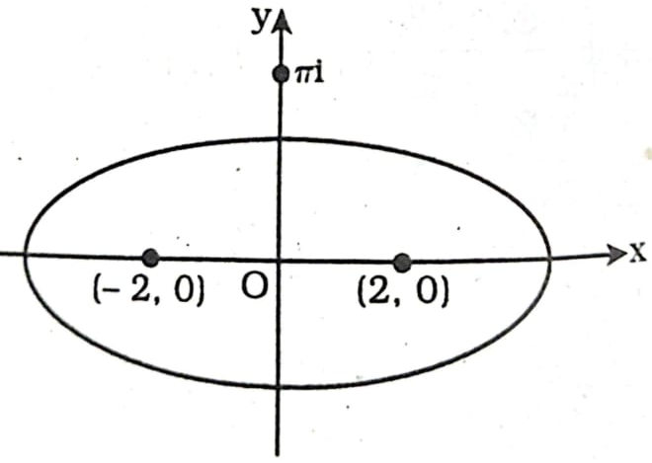

Slide 9
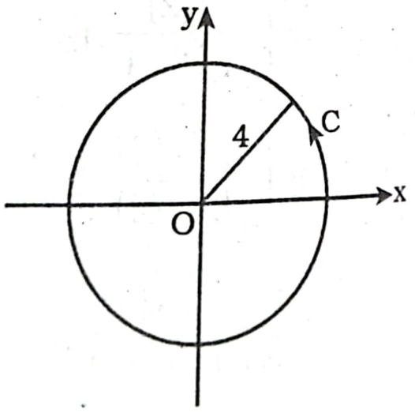
Do Yourself

Slide 11
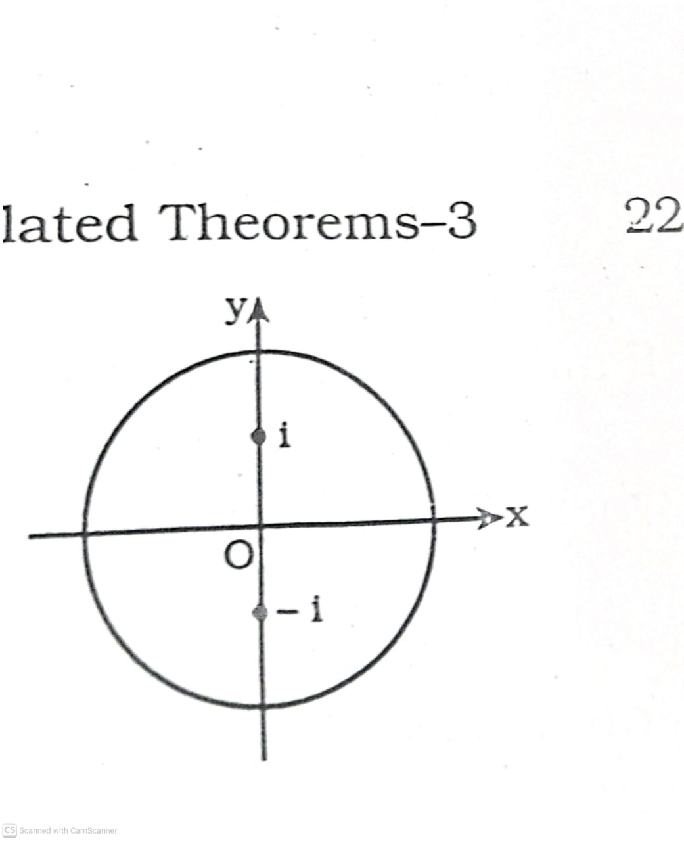

Slide 12
Do Yourself

Slide 13
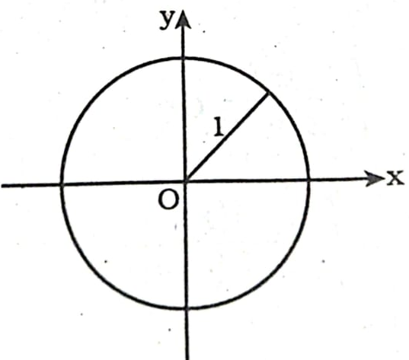
Do Yourself

